Slide 1
Financial Well-Being and You
A Self-Assessment Activity
Copyright © 2024 National Endowment for Financial Education. All rights reserved.

Slide 2
Money and Me: A Fun Quiz
Consider each question.
Select the answer that fits best for you.
Keep in mind that there are no right or wrong answers.
Notes:
Slides 3 through 8 provide “quiz” questions for students to answer. Each has prompts in the presenter notes for further discussion.

Slide 3
Money and Me: Question 1
You receive an assignment to interview a parent, guardian or family member about some of their biggest financial challenges. You:
Cringe thinking about how badly that might go.
Tell your friends you won’t be around tonight because you’re sure this will last forever.
Figure this won’t be too bad — you’ll probably learn some good information.
Wish you could get a real answer to this but don't think you will.
Notes:
Acknowledge that every family is different when it comes to talking about money. Some find these conversations easy and frequent, while others consider finances a taboo topic.
Ask students if they thought about a particular family member when they considered this question.

Slide 4
Money and Me: Question 2
You’re starting a new job, and your employer tells you to bring your bank’s routing number and your account number to orientation. You:
Have no idea what they mean by that.
Know exactly where to find that information.
Aren’t 100% sure but know who to ask for help.
Can’t provide it since you don’t have an account.
Notes:
Ask if any students have encountered this situation. Consider inviting one student to describe their experience.

Slide 5
Money and Me: Question 3
You’re scrolling through social media and see a video about ways teens can start investing. You:
Keep scrolling — totally uninterested.
Watch for a second, but don't find it relevant to your life.
Watch, like and subscribe.
Know it would never happen because you aren’t on social media.
Notes:
Ask if students follow personal finance influencers on social media and/or have seen personal finance content in their social media feeds. If so, invite a student to share who they follow and/or describe the content they have seen.

Slide 6
Money and Me: Question 4
You hear that your favorite artist will be on tour near where you live. You:
Immediately purchase the best seats you can afford.
Determine that you will save up money in time to go.
Ask for tickets as an early gift from a family member.
Think spending money on concert tickets is a waste.
Notes:
Ask students if they have ever been to a concert. If so, did they compare ticket costs and/or make decisions about seating based on price? Have they discussed ticket prices with a family member or friend before? Who would they want to see? Do they have an idea of what tickets cost?
For students that may not be interested in concerts, is there something comparable for them such as tickets to a sporting event?

Slide 7
Money and Me: Question 5
A friend says they have been saving money to get a car. You:
Wish you’d been doing the same thing.
Let them know you have been saving up, as well.
Are glad this isn’t something you have to worry about.
Aren’t much of a saver and don’t plan to start anytime soon.
Notes:
Ask students with A and B responses about the car they imagine purchasing. Do they have a specific one in mind? How much do they think they will need to save?
Acknowledge that there are many reasons that people might select option C. For example, they may not want or need a car or one might already be available to them.
Remind students who respond with C or D that it is never too late to change their attitude toward saving. Acknowledge, too, that some students may not have earned money that can be saved.

Slide 8
Money and Me: Question 6
Your teacher asks you to give yourself a grade reflecting how much you currently know about personal finance. You:
Give yourself a solid A+! You are confident in your financial knowledge!
Figure you are somewhere in the B range. You feel confident about things you deal with now but expect to encounter new topics as you get older.
Aren’t too confident — maybe a C or D.
Would give yourself an F now but figure there’s nowhere to go but up.
Notes:
Acknowledge all responses and encourage students that they will learn more in the course or unit you are teaching. Remind students that financial education is something they can get both in class and on their own as they get older. Experience is an excellent way to broaden financial knowledge and skills.
Consider sharing something about personal finance that you recently learned or needed to understand better.

Slide 9
Background on Financial Well-Being
and the
Personal Finance Ecosystem
Notes:
Slides 9-17 are optional and provide additional background on financial well-being and the Personal Finance Ecosystem. There are additional notes for background as well as some discussion prompts.

Slide 10

Financial Well-Being
Everyone has a level of Financial Well-Being; it’s not a single endpoint
Self-assessed; changes over time
Includes:
Satisfaction with managing present situation
Feeling of having choices
Feeling some control over life
How you feel about the future
Notes:
Financial Well-Being is an ever-changing, personal state. It typically includes factors such as satisfaction with managing one’s current financial situation; the freedom to exercise choice and feel in control of finances; and the outlook for future prospects. It’s determined at a point in time and gives a “temperature check” on how a person feels about their finances. It is subjective and different for each person.
Discussion Prompts:
Have you ever been to a doctor and asked to rate your physical pain on a scale of 1-10?
With the same injury or condition, do you think everyone would give the same rating? What might influence how a person rates their pain? Financial well-being is similar. Even with comparable financial circumstances, people can easily rate their financial well-being differently.

Slide 11
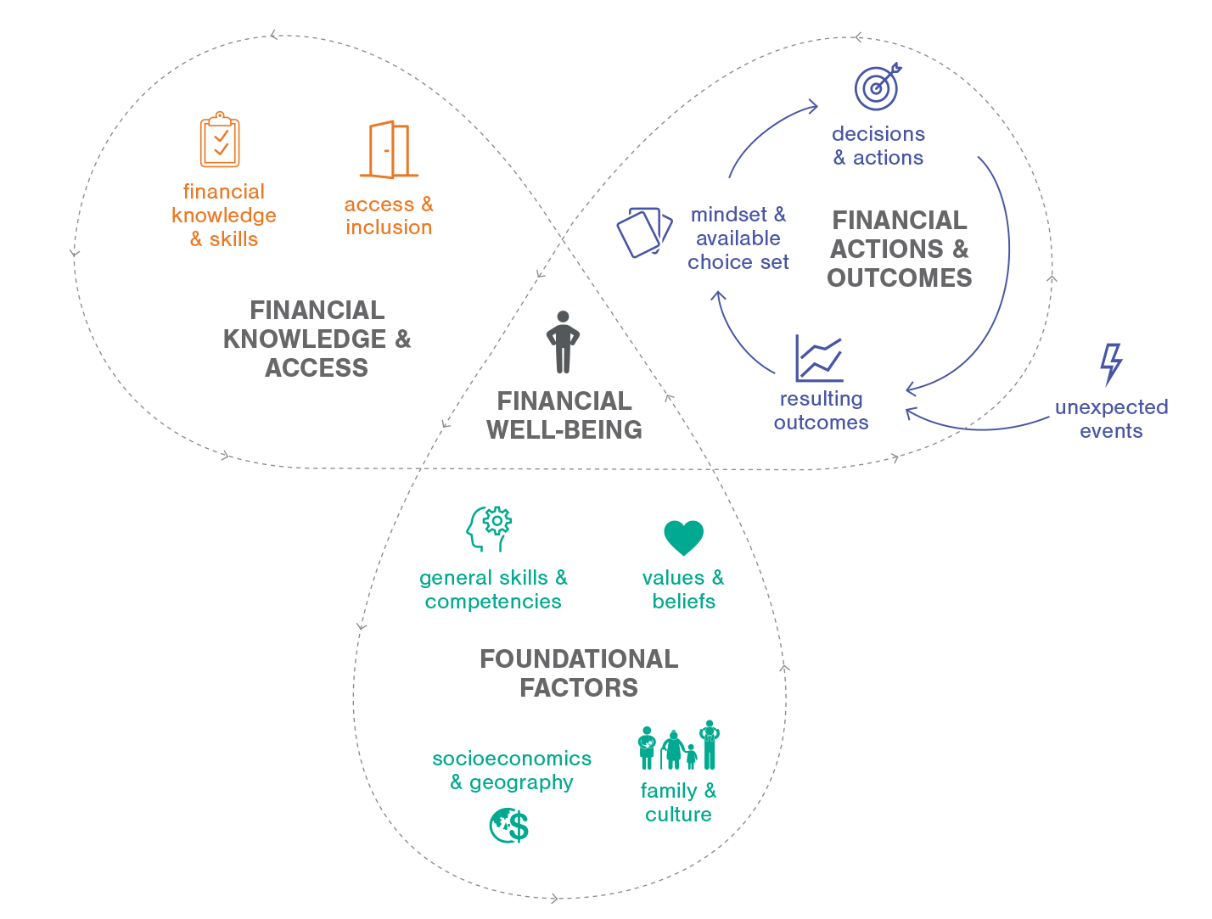
Core Elements of the Personal Finance Ecosystem
Notes:
Financial well-being is influenced by many factors. These are illustrated in the Personal Finance Ecosystem and organized into three areas:
Foundational Factors, which are internal and external factors such as their general skills and competencies, values and beliefs, and a range of cultural, familial, and socioeconomic factors.
Financial Knowledge and Access, which is their current level of financial knowledge/skill and their access to financial products and services.
Financial Actions and Outcomes: which are the actions they take (including inaction), decisions they make, and the resulting outcomes. Unexpected events also play into this cycle.
None of these components are things that you either have or you lack. Each person possesses these to some degree or another, which you'll see as we dive in more deeply. For example, your financial knowledge and skills are housed within Financial Knowledge and Access. Your knowledge level could be high, low, or somewhere in between, but you possess a level of knowledge nonetheless.
Discussion Prompts:
What do you notice about the Personal Finance Ecosystem?
What do you wonder about it?

Slide 12
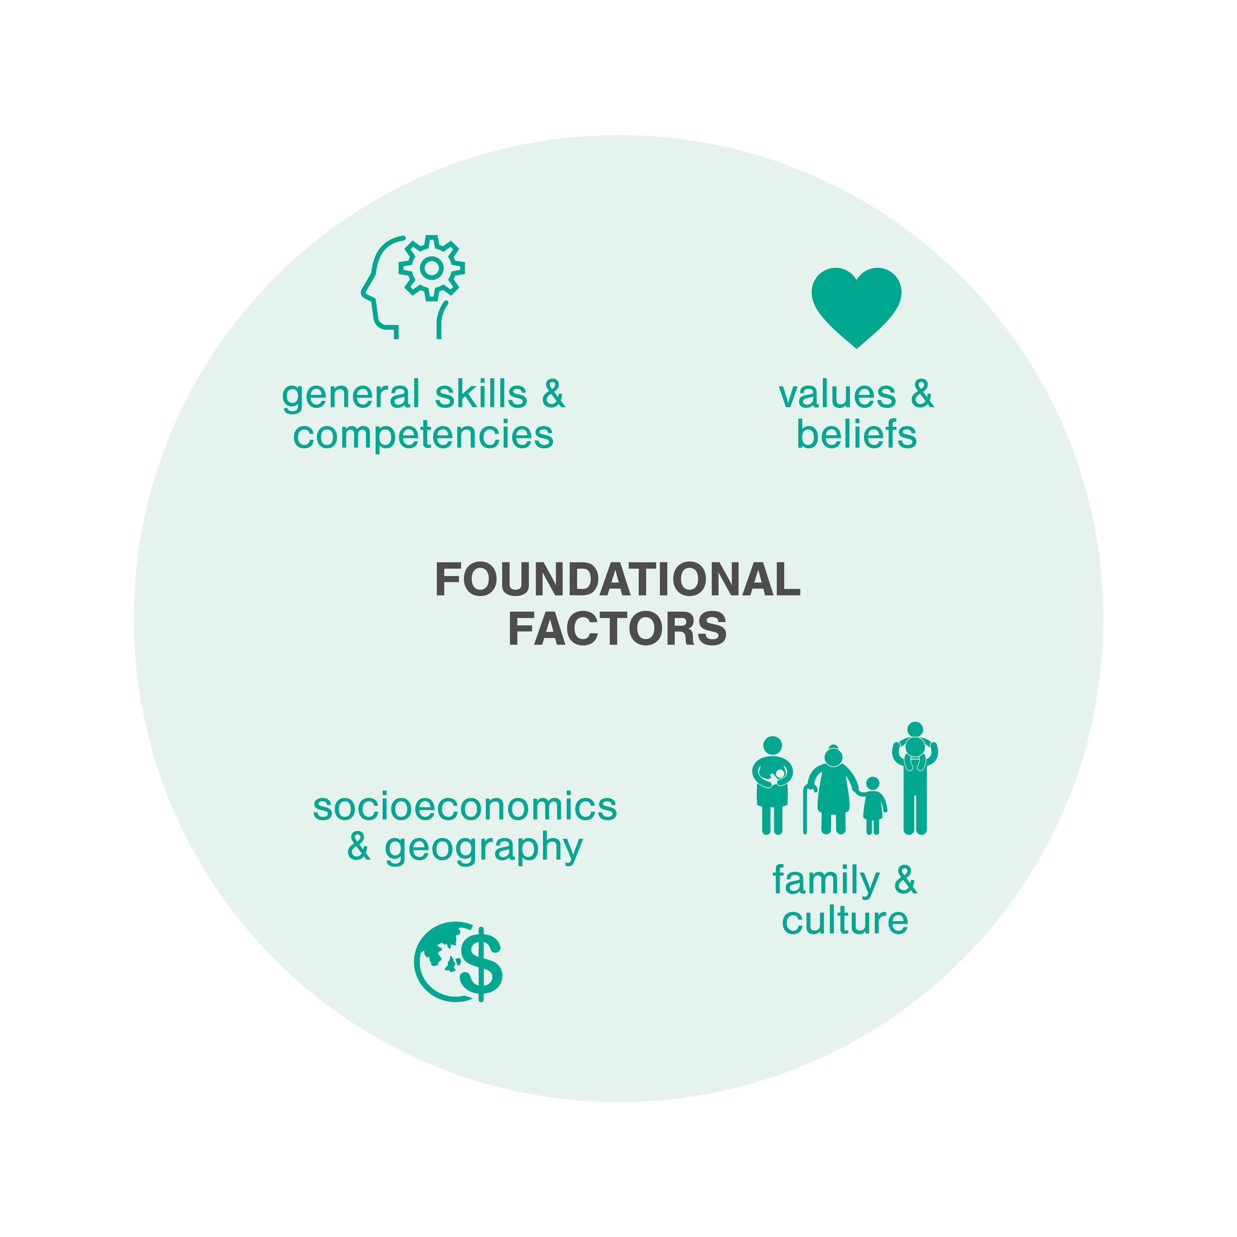
Foundational Factors
Wide variety of aspects that influence each part of the framework
Factors are relevant for all individuals, but uniquely influence each person
Includes both internal and external factors
Notes:
The foundational factors are just that – foundational and underlying.
Discussion Prompts:
What else can you think of that has a foundation?
How does the foundation influence other parts? (Potential examples: a home or building, a cheerleading “pyramid,” a stack of wood)

Slide 13


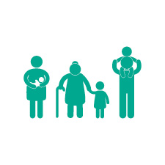

Foundational Factors
General Skills and Competencies
Values and Beliefs
Family and Culture
Socioeconomics and Geography
Includes basic literacy and numeracy, problem-solving skills, critical thinking, information literacy, executive function, self-advocacy, communication, and persistence.
Includes internal factors like motivation, affect, attitudes, cognitive bias, time discounting, risk preference, stress, trust in the financial system, and other mental constructs.
Includes personal factors like family socialization, family composition, and culture.
Includes overarching factors like the state of the economy, socioeconomics and systemic inequality, and issues specific to a particular region or locale.
Notes:
General Skills and Competencies include things like basic literacy and numeracy, problem-solving skills, and executive function.
Values and Beliefs include important mental constructs like motivation, affect, attitudes, cognitive bias, time discounting, risk preference, and stress. These are considered foundational because many of these impact a person’s willingness to learn in the first place. Trust in the financial system is here because it often affects a person’s willingness to engage with other parts of the Ecosystem.
Family and Culture include family socialization and how family composition can affect someone’s financial life. For example, is it a mutigenerational household? Has an individual experienced divorce? How many children are there? What is their documentation status?
Socioeconomics and Geography touch on economic disparities and systemic inequities that people experience. It also acknowledges that many economic opportunities and challenges are place-based and can vary widely by region and even zip code.
Discussion Prompts:
How do you picture each of these impacting a person’s financial well-being?
Do you think one of these is more important than the others? Why?

Slide 14
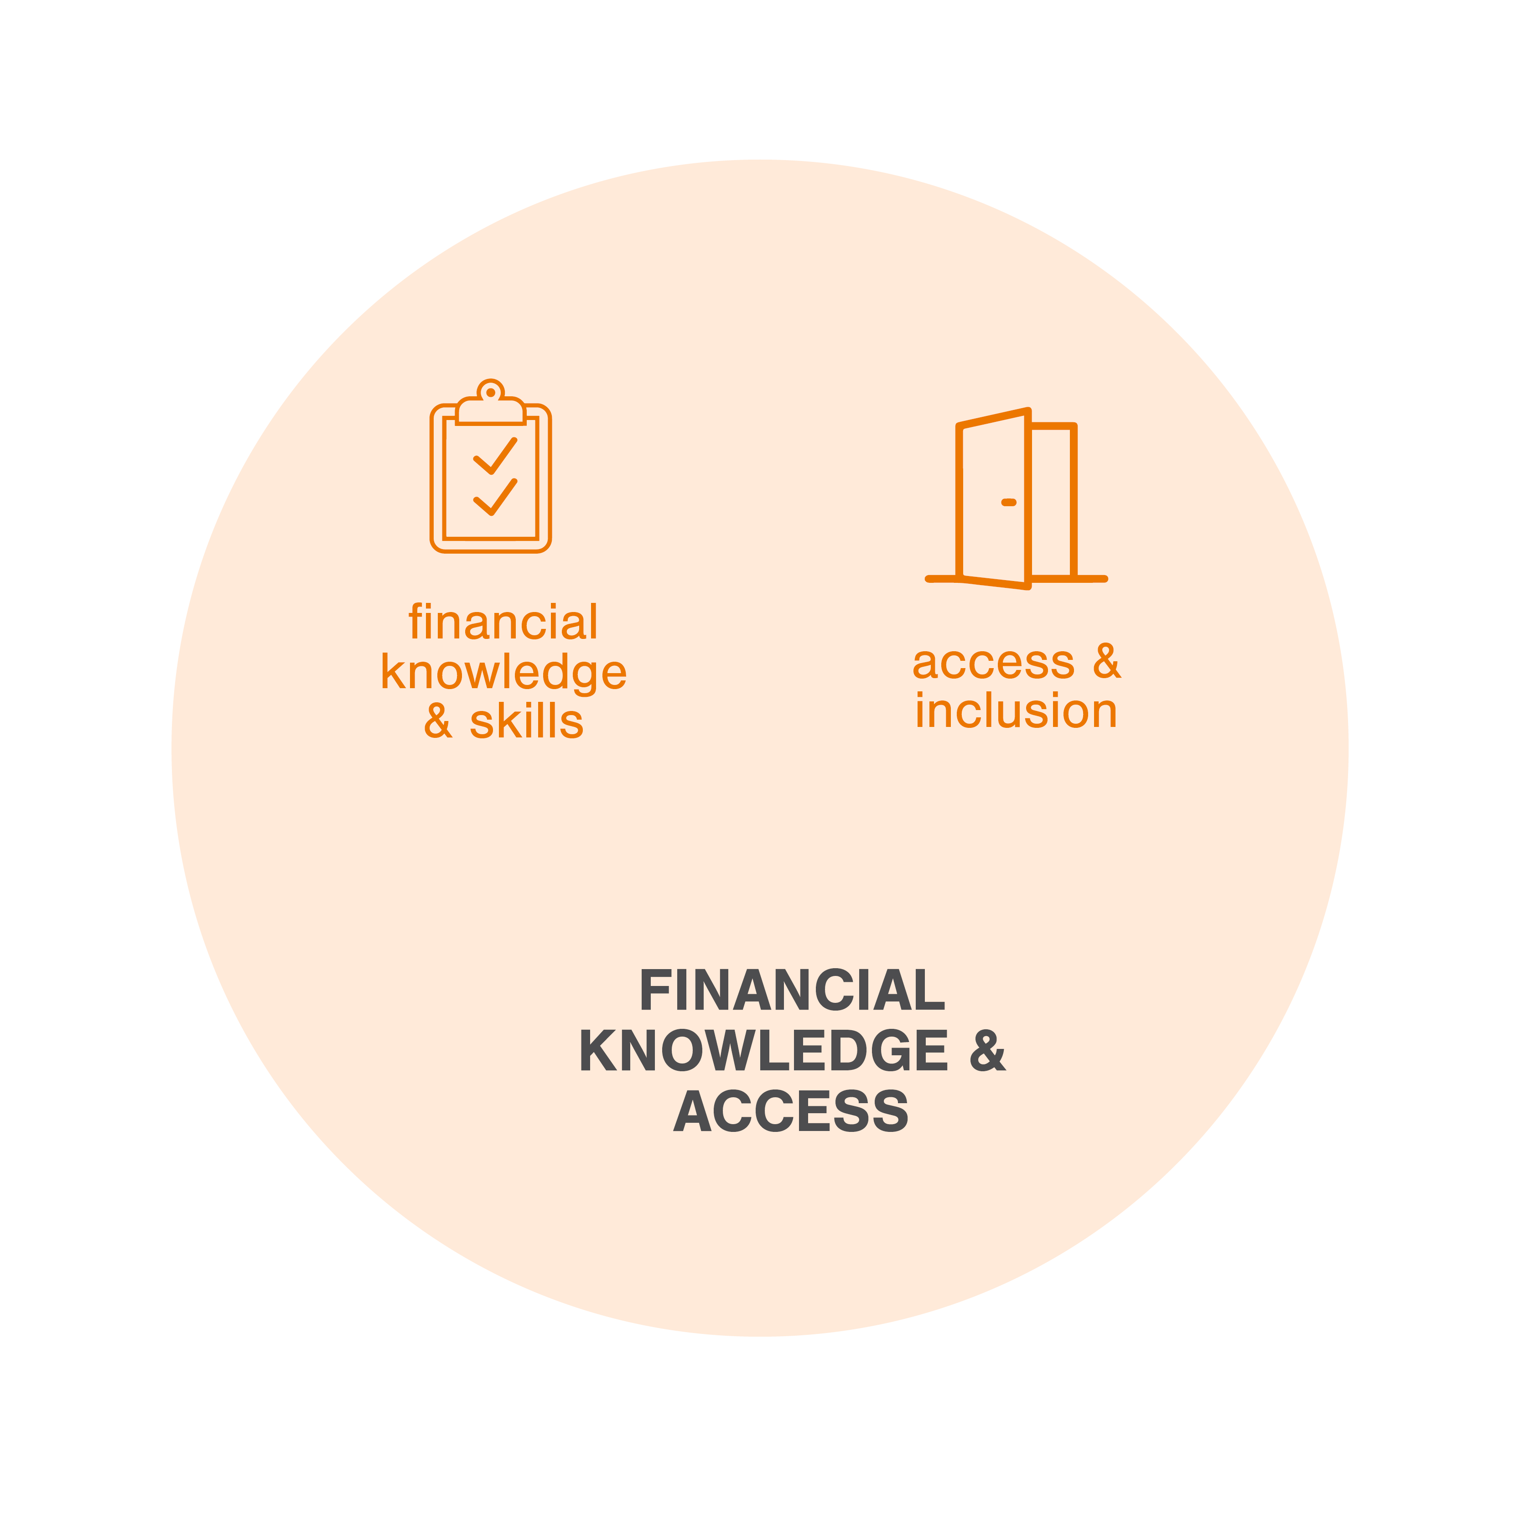
Financial Knowledge and Access
An individual’s ability to act in their own self-defined best financial interest
Comprised of two key elements:
Financial knowledge and skills to decide or act
Opportunity to take action and exercise choice within financial society
Notes:
Financial knowledge and access are key to financial well-being.
Discussion Prompts:
Aside from classes in personal finance, how might people gain financial knowledge and skills?
What do you think is meant by access and inclusion?

Slide 15


Financial Knowledge and Access
Financial Knowledge and Skills
Access and Inclusion
Financial Knowledge: Objective mastery of financial definitions, terms and concepts.
Financial Skills: Determines whether an individual can make decisions with that knowledge.
Skill puts knowledge into action!
Participation in Financial Society: The opportunity and awareness to take action and exercise choice within financial markets, the financial services industry, and all aspects of financial life.
Many individuals face systemic barriers to full inclusion.
Notes:
Financial Knowledge and Skills can be built through formal or informal education and training. Some people might say they gain financial knowledge from “the school of hard knocks.” In other words, they learn from their experiences what not to do.
People lack Access and Inclusion in financial society in many ways. For example, people who live in very rural areas often lack access to financial institutions. There are also systemic barriers to inclusion, such as discrimination in lending.
Discussion Prompts:
How have you gained financial knowledge and skills? Do you think people learn better from education or experience?
Do you think people in your community have full access and inclusion in financial society? Can you think of other examples where people lack this access or inclusion?

Slide 16
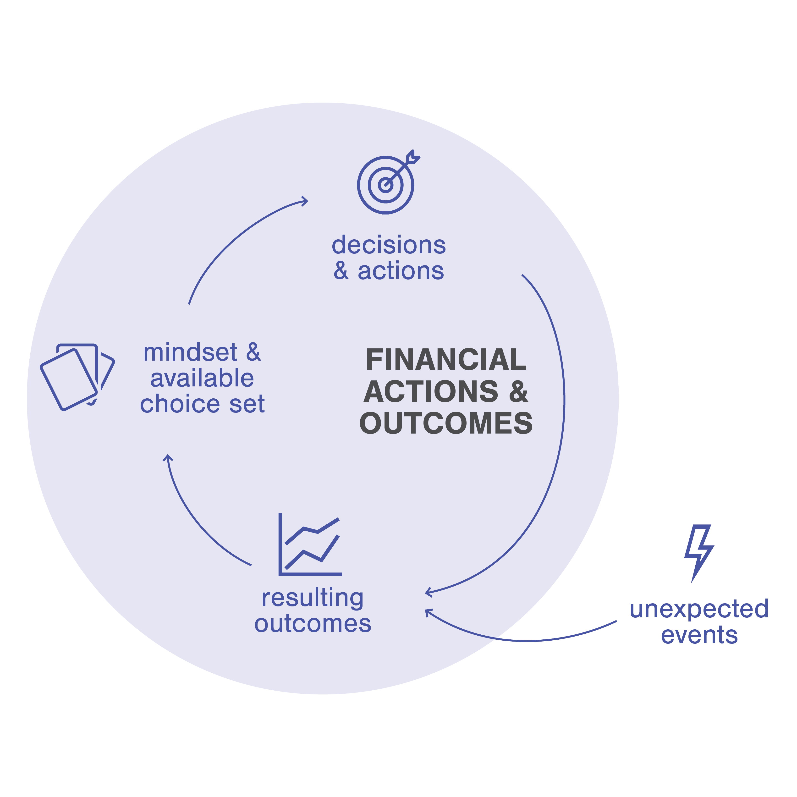
Financial Actions & Outcomes
We all make frequent financial decisions, large and small
Cycle starts with Mindset & Available Choice Set
Financial knowledge and skill play a big part here
Decisions & Actions lead to Outcomes
Unexpected Events can also affect outcomes/feelings
Notes:
The Financial Actions and Outcomes Cycle is a feedback loop made up of mindset and available choice set, decisions and actions, and the resulting outcomes from those decisions. These outcomes in turn affect mindset and choice set, and so on.
This is where financial decision-making lives within this framework. While Financial Well-Being is something you define for yourself, the financial actions that you take and the results of those actions play a large part in that well-being. People make financial decisions all the time, from daily purchasing decisions to big-picture choices like whether to go to college, where to live, or what job to take.
The starting point of this cycle is mindset and available choice set, which is how you feel about the decision going into it and what choices are actually on the table for you to make. Financial Knowledge and Skill have a big part to play here, including your confidence, your objective knowledge, and how you apply that knowledge to the choice at hand. If you can act in your own best financial interest, your mindset and available choices will likely shift.
Once a financial decision or action is made, an outcome happens. These are both objective (like having a new bank account) and subjective (like feelings of satisfaction).
Outcomes also happen from unexpected events, like getting a flat tire and having to pay to replace it. Or maybe it’s a positive unexpected event, like a raise at work. It’s important to note that not all financial disruptions can be prepared for or are an outflow of financial decisions and actions. Like several other components of the Ecosystem, there are some things that an individual cannot change or control, but they still impact the outcomes that a person experiences.
How you feel about this ongoing relationship between mindset, actions, and outcomes—or the subjective impact they have on your situation—feed into well-being.
Discussion Prompts:
What are some unexpected events that might impact a person’s financial decisions?
How could mindset influence a person’s financial decisions and actions?

Slide 17




Financial Actions and Outcomes Cycle
Mindset and Available Choice Set
Decisions and Actions
Resulting Outcomes
Unexpected Events
A set of mental attitudes at the time of a financial decision and choices that are available to an individual at any given time.
The presence or absence of decisions made and actions taken by an individual.
Outcomes can be objective (confidence) or subjective (credit score); can result from decisions and actions as well as from unexpected events.
Economic shocks that a person experiences; can be positive (a wage increase) or negative (large medical bill, job loss).
Notes:
This shows more details about each component of the cycle. Remember, this is a continuous loop that repeats with each additional decision or action.
Discussion Prompts:
Think of a financial decision that you or someone you know has made.
Can you identify the components of this loop?
What mindset did you or the other person have going into the decision? What choices were available at the time?
What decision was made or action taken?
Was an unexpected event involved?
What was the resulting outcome?
How will this experience impact future financial actions?

Slide 18
Review: Core Elements
Notes:
To review, everyone:
Has a current level of financial well-being,
Is making financial decisions and experiencing outcomes,
Has a current level of financial skill and access,
And is impacted by their Foundational Factors, including systemic barriers.
Financial Well-Being shifts based on a complex combination of all the other elements in the Ecosystem.
Discussion Prompts:
Where do you think each of the “quiz” questions fits in the ecosystem?
1. Response from family members if asked about a financial challenge
(Potential answer(s): Family & Culture; Values & Beliefs)
2. Ability to provide an employer with your bank’s routing number and your account information
(Potential answer(s): Financial Knowledge & Skills; Access & Inclusion)
3. Seeing and/or following personal finance content/influencers on social media
(Potential answer(s): Decisions & Actions; Resulting Outcomes; Mindset & Choice Set, Values & Beliefs. If viewing the complete Personal Finance Ecosystem, this could also tie into various Catalysts for Change, including Knowledge Influencers and Behavior Influencers.)
4. Spending money on concert tickets
(Potential answer(s): Values & Beliefs; Family & Culture; Decisions & Actions; Mindset & Available Choice Set; Socioeconomics & Geography)
5. Saving money for a car
(Potential answer(s): Socioeconomics & Geography; Mindset and Available Choice Set)
6. Current grade for personal finance knowledge
(Potential answer(s): Financial Knowledge & Skills; Values & Beliefs; General Skills & Competencies)

Slide 19
Notes:
You can find more about Personal Finance Ecosystem at www.NEFE.org/Ecosystem

