Slide 1
An Introduction to the
Personal Finance Ecosystem
Presentation Date, Time
Presenter Name
Copyright © 2024 National Endowment for Financial Education. All rights reserved.

Slide 2
Tell Us What You Think
We’re going to read a few statements aloud.
If you agree… raise one hand 
If you strongly agree… raise two hands  
If you disagree… keep your hand down 
If you’re unsure… wave or shake your hands 

Slide 3
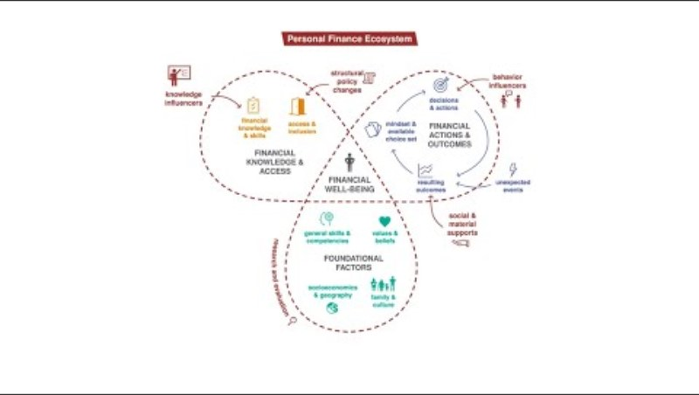
Video Overview
3

Slide 4
About the Personal Finance Ecosystem
The Personal Finance Ecosystem is a conceptual framework that describes the factors that influence an individual's state of financial well-being.
It was created by the National Endowment for Financial Education (NEFE), a national nonprofit providing leadership, research and collaboration to advance financial well-being.
4

Slide 5
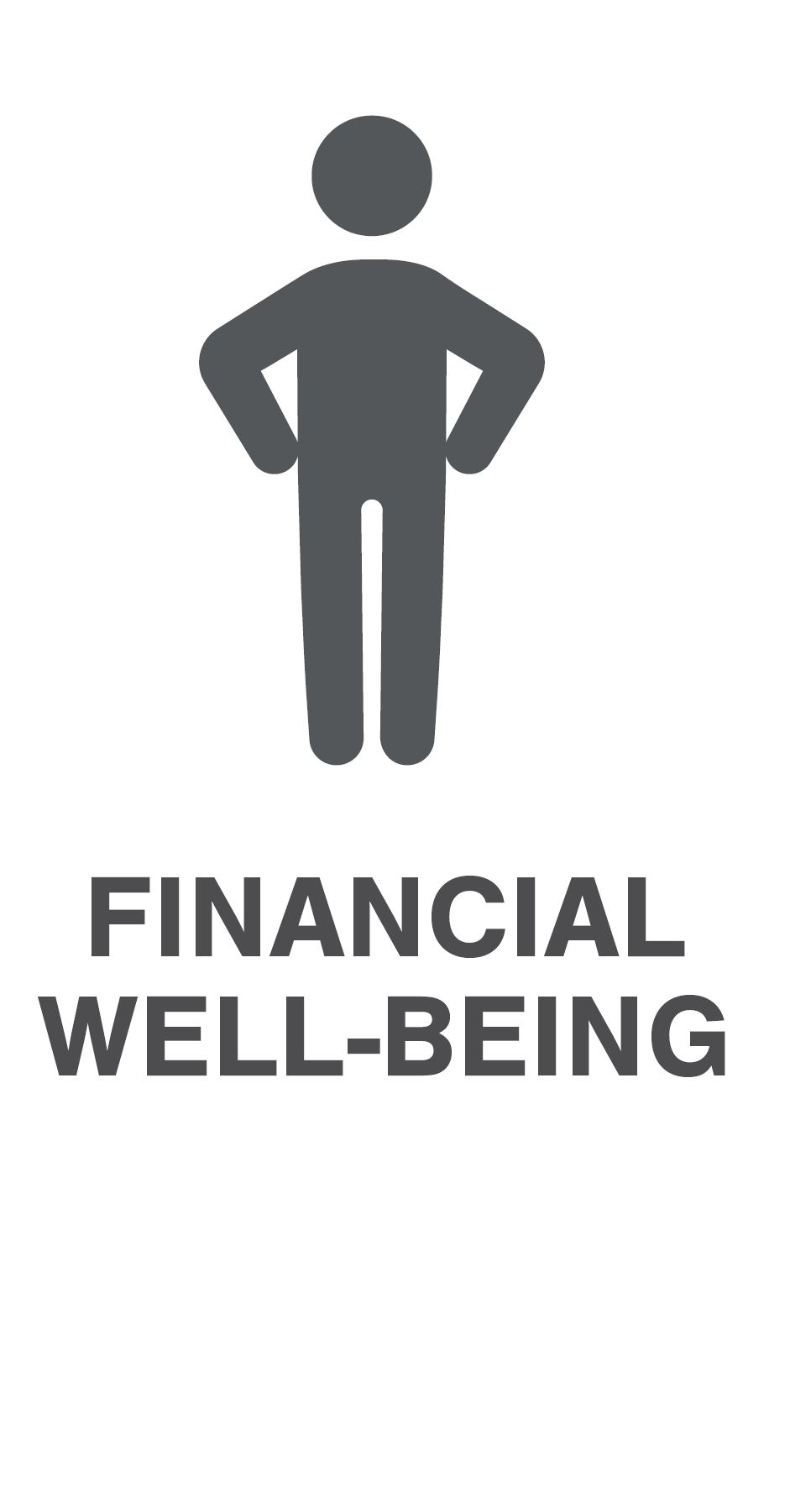
Defining Individual Financial Well-Being
Everyone has a level of Financial Well-Being. An individual never “achieves” financial well-being as it is not a static end point
Self-assessed; changes over time
Includes:
Satisfaction with managing present situation
Feeling of having choices
Feeling some control over life
How you feel about the future

Slide 6
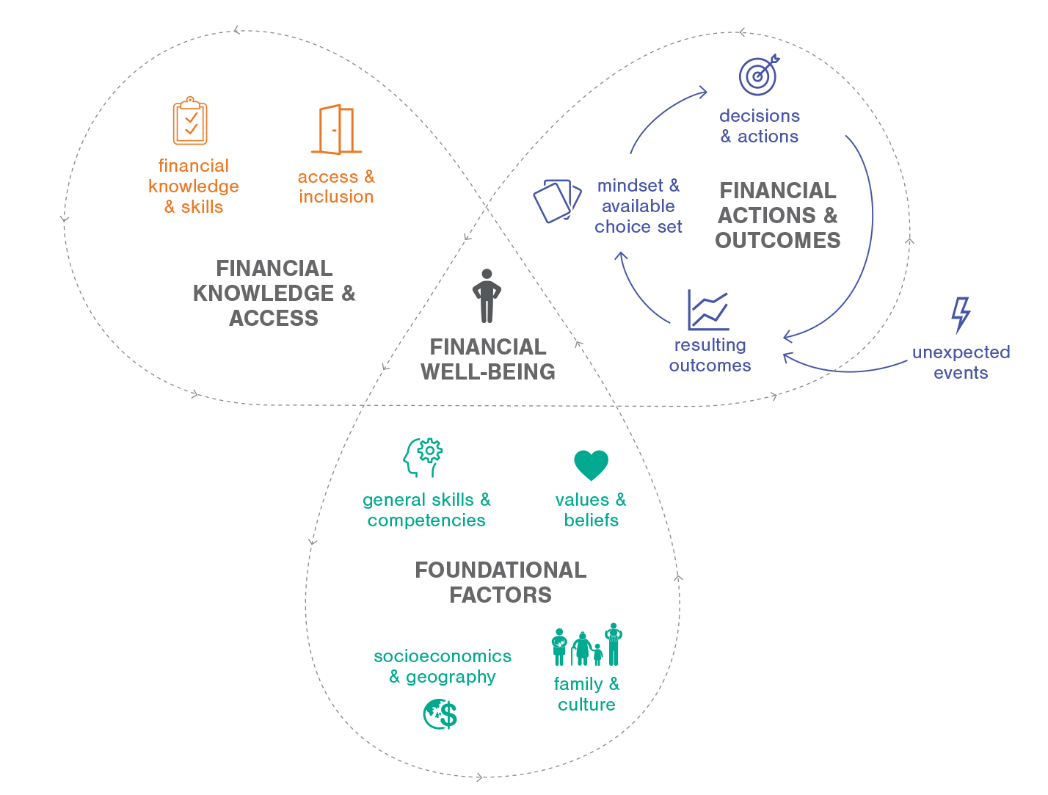
Zooming Out: Ecosystem Core Elements

Slide 7
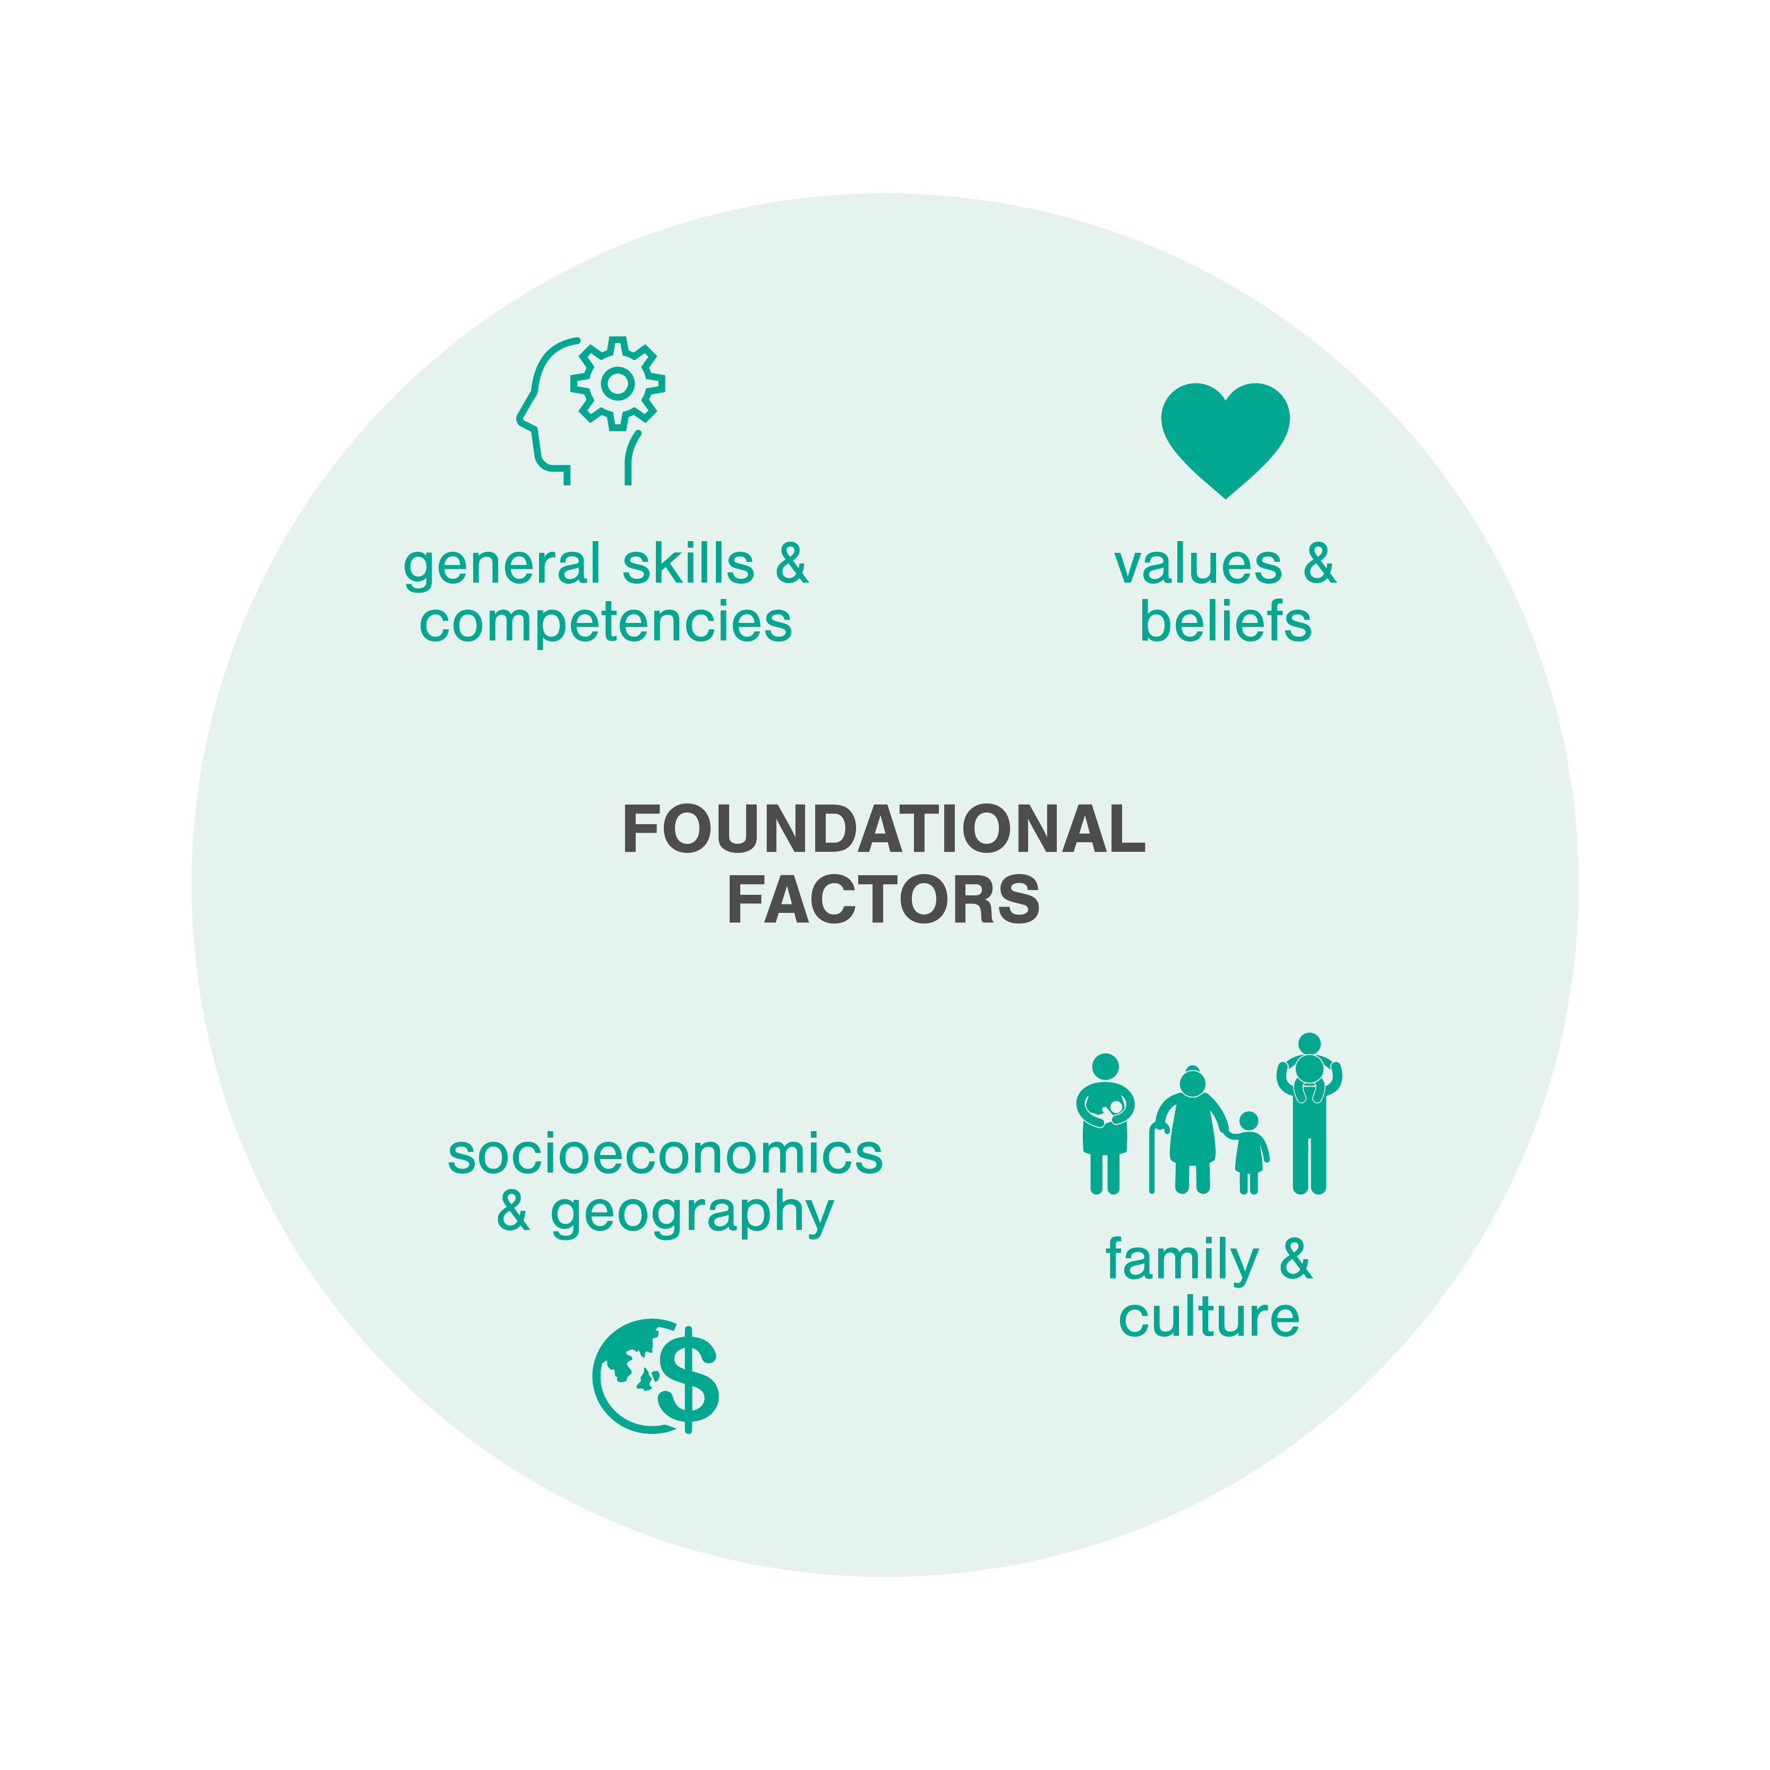
Foundational Factors
Foundational Factors influence financial well-being at a fundamental level
Factors are relevant for all individuals, but uniquely influence each person
Includes both internal and external factors

Slide 8


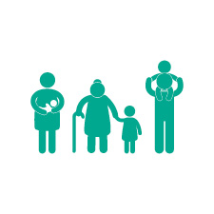

Foundational Factors
General Skills and Competencies
Includes basic literacy and numeracy, problem-solving skills, critical thinking, information literacy, executive function, self-advocacy, communication, and persistence.
Values and Beliefs
Includes internal factors like motivation, affect, attitudes, cognitive bias, time discounting, risk preference, stress, trust in the financial system, and other mental constructs.
Family and Culture
Includes personal factors like family socialization, family composition, and culture.
Socioeconomics and Geography
Includes overarching factors like the state of the economy, socioeconomics and systemic inequality, and issues specific to a particular region or locale.

Slide 9
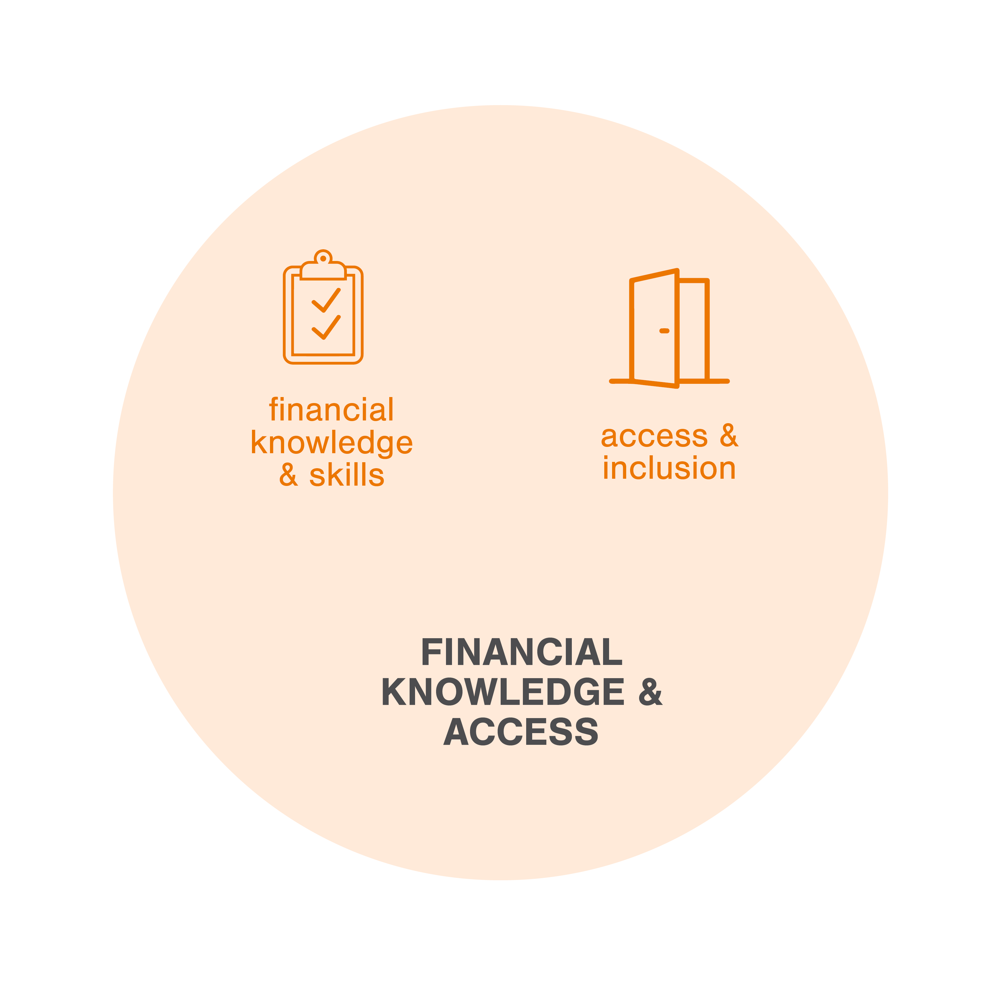
Financial Knowledge and Access
An individual’s ability to act in their own self-defined best financial interest.
Comprised of two key elements:
Financial knowledge and skills to decide or act
Opportunity to take action and exercise choice within financial society

Slide 10


Financial Knowledge and Access
Financial Knowledge and Skills
Financial Knowledge: Objective mastery of financial definitions, terms and concepts.
Financial Skills: Determines whether an individual can make decisions with that knowledge.
Skill puts knowledge into action!
Access and Inclusion
Participation in Financial Society: The opportunity and awareness to take action and exercise choice within financial markets, the financial services industry, and all aspects of financial life.
Many individuals face systemic barriers to full inclusion.

Slide 11
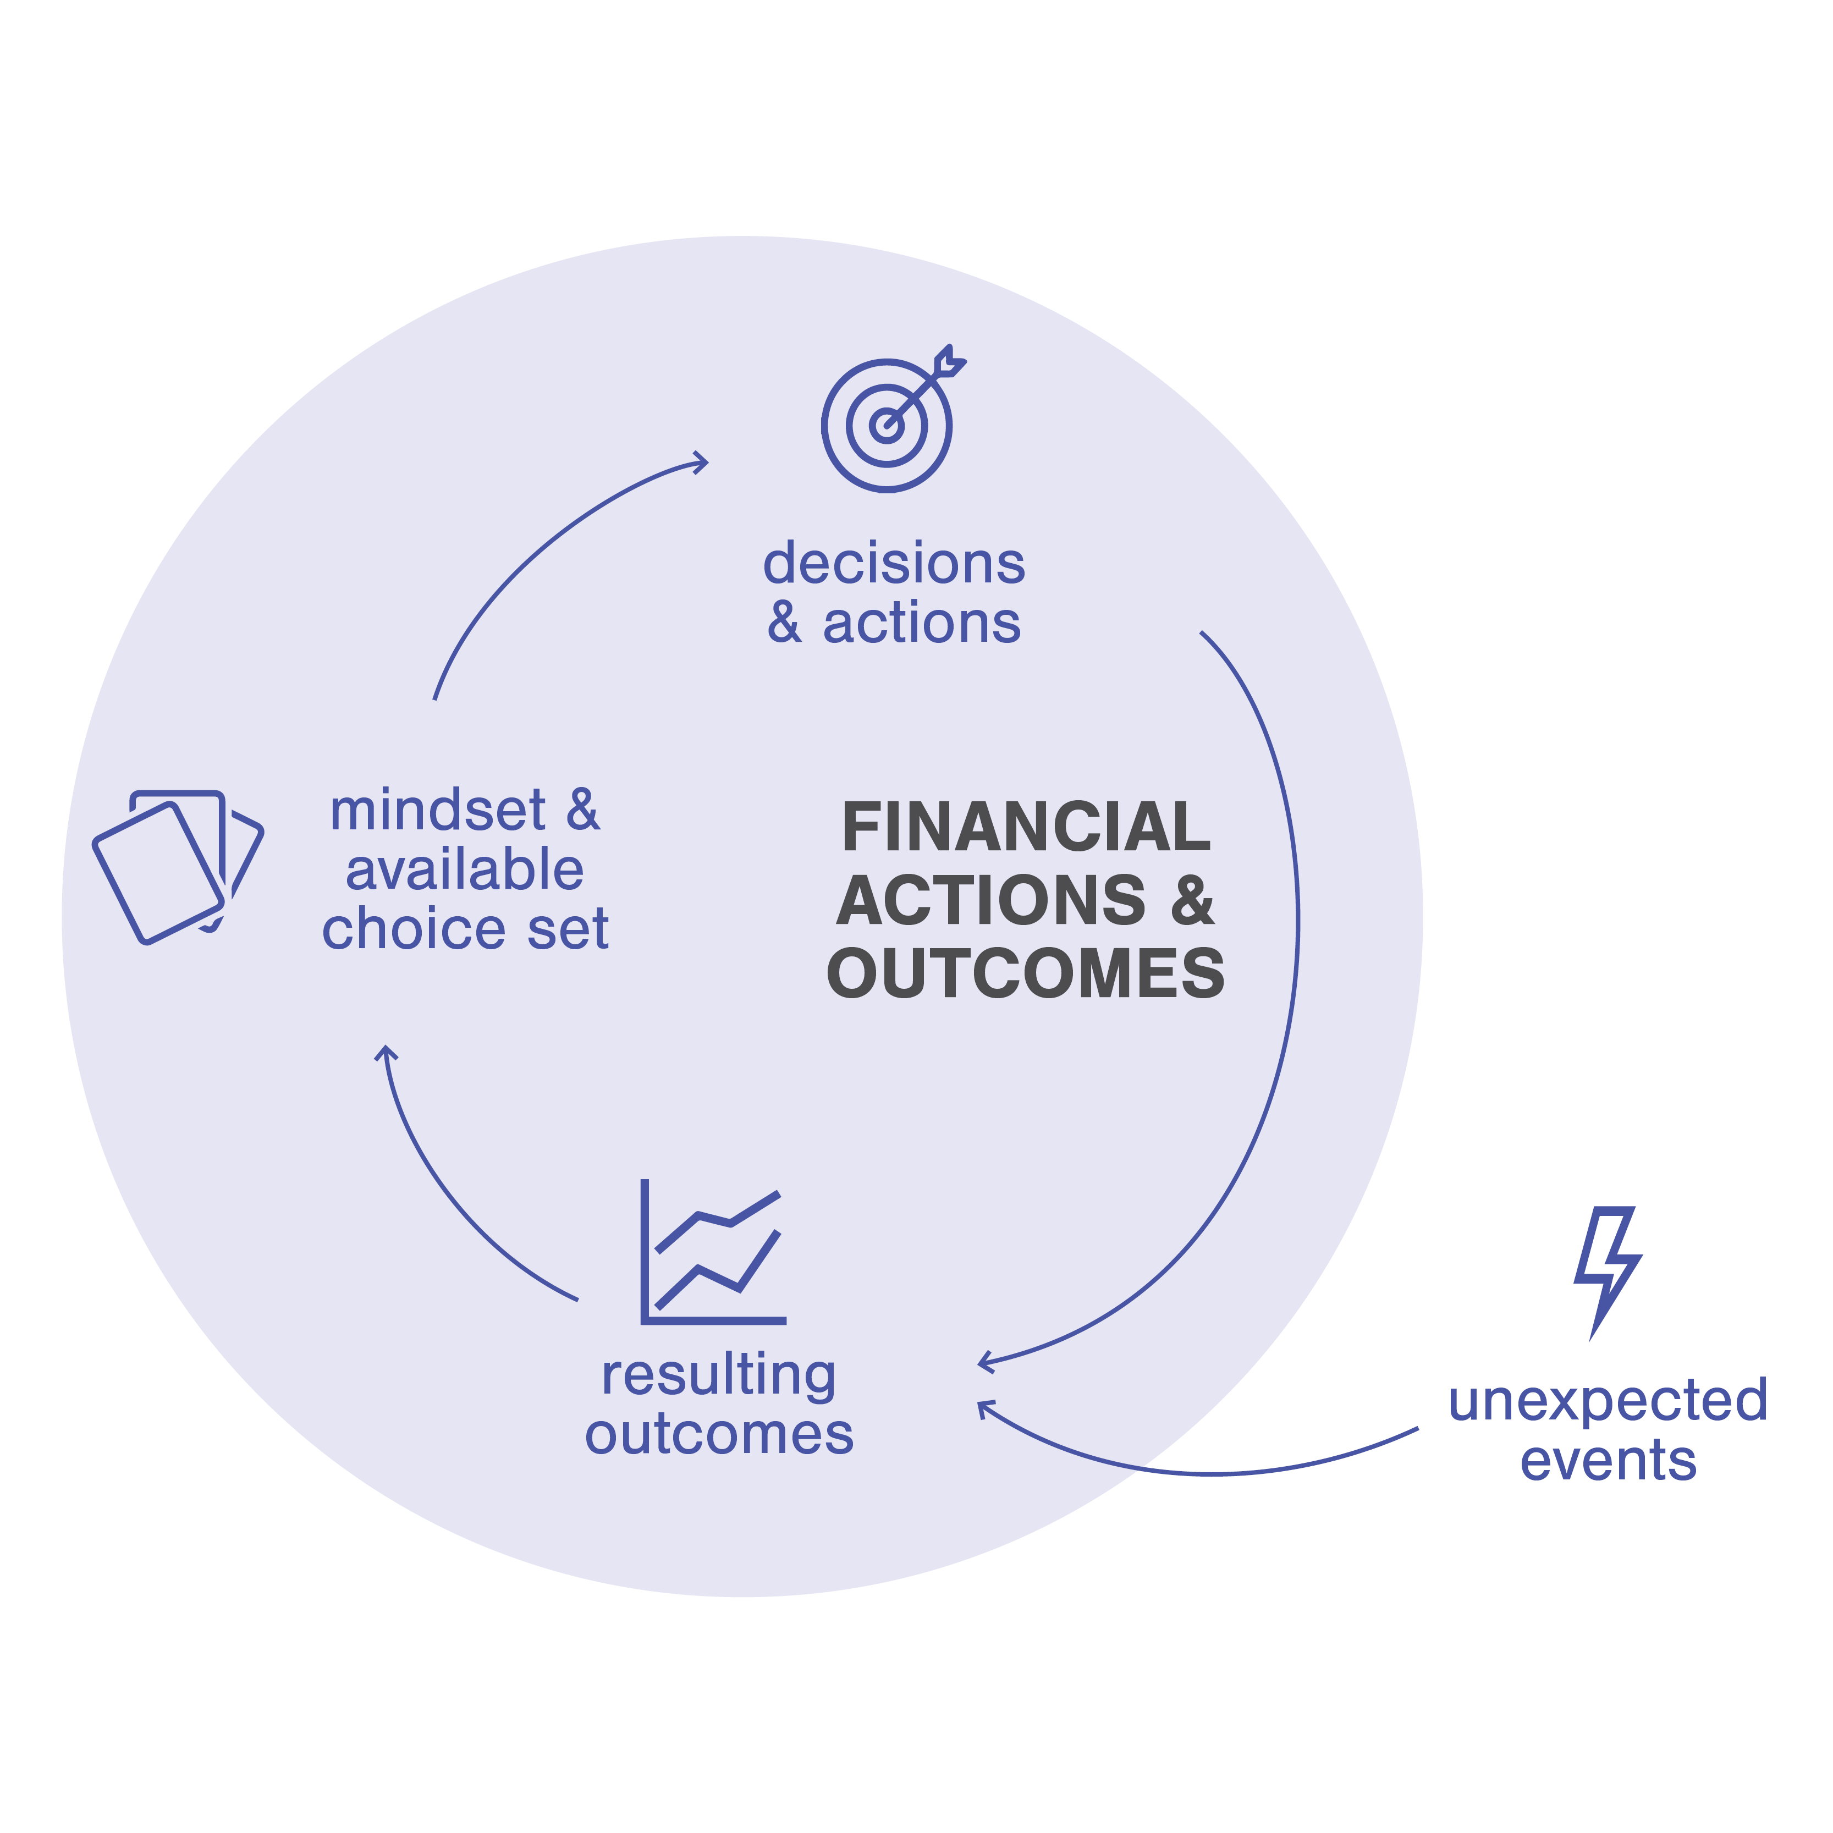
Financial Actions and Outcomes
We all make frequent financial decisions, large and small
Cycle starts with Mindset & Available Choice Set
Financial knowledge and skill play a big part here
Decisions & Actions lead to Outcomes
Unexpected Events can also affect outcomes/feelings

Slide 12




Financial Actions and Outcomes
Mindset and Available Choice Set
A set of mental attitudes at the time of a financial decision and choices that are available to an individual at any given time.
Decisions and Actions
The presence (or absence) of decisions made and actions taken by an individual.
Resulting Outcomes
Outcomes can be objective (confidence) or subjective (credit score); can result from decisions and actions as well as from unexpected events.
Unexpected Events
Economic shocks that a person experiences; can be positive (a wage increase) or negative (large medical bill, job loss).

Slide 13
Review: Core Elements

Slide 14
What elements of the Ecosystem do you think are within an individual’s control? What elements are outside their control?
Discussion
14

Slide 15
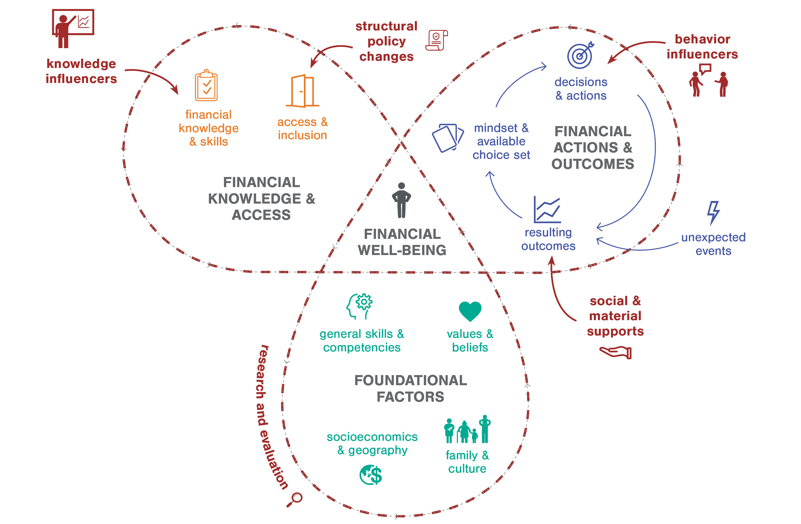
Catalysts for Change

Slide 16
Catalysts for Change
Catalysts for Change
Knowledge Influencers | Structural Policy Changes | Behavior Influencers | Social and Material Supports
Purpose is to increase or strengthen financial knowledge or skill May end up changing behavior, but the desired outcome is knowledge gain. | Purpose is to increase access to and inclusion in the formal financial sector | Purpose is to impact behavior and decisions. May also increase knowledge/skill but the desired outcome is behavioral. | Purpose is to change the effects of an outcome that comes from the cycle. Sources include government and nonprofits.
Two types: Financial Education Financial Information and Tools | Examples: a regulation requiring rent reporting to credit agencies, fair lending, accessible banking products | Examples: coaching, nudges, expert advice, FinTech apps | Examples: unemployment insurance, nonprofit clinics, housing vouchers

Slide 17
How do you support financial well-being? Where do you see yourself within the Personal Finance Ecosystem?
Discussion
17

Slide 18
Conclusion and Takeaways
The Personal Finance Ecosystem helps stakeholders to:
Better understand the full range of factors influencing financial well-being.
Orient themselves to the financial well-being field.
Spark ideas for collaboration, partnership, and participation within movements for change.
Calibrate expected outcomes to align with specific interventions; financial education is not a magic solution, nor is any other single Catalyst.
Prompt research questions and open new lines of inquiry.
18

Slide 19
19

Slide 20
About NEFE and the Personal Finance Ecosystem
About NEFE
The National Endowment for Financial Education (NEFE) champions effective financial education. We are the independent, centralizing voice providing leadership, research and collaboration to advance financial well-being. NEFE is a 501(c)3 nonprofit foundation based in Denver, Colorado.
About the Personal Finance Ecosystem
The Personal Finance Ecosystem is an evolving framework first conceptualized by NEFE in early 2019 to synthesize observations from research and practice across the financial well-being field.
In the years that followed, and in consultation with the field, the model evolved a second and then a third time. The current version—released in 2022—is a product of extensive, evolving feedback and field-tested concepts and visuals.
NEFE first developed the Personal Finance Ecosystem to examine how financial education efforts fit within the broader context of the financial well-being field. The Ecosystem continues to illustrate the limitation of a financial-education-only approach to financial well-being.
For more information, visit www.nefe.org/ecosystem.
20

