Slide 1
What Influences Financial Well-Being??
A Hexagonal Thinking Activity
Copyright © 2024 National Endowment for Financial Education. All rights reserved.

Slide 2

What Do You Think About?
Notes:
Ask students how they would explain the term financial well-being. If desired, direct students to write their responses and then share them with a classmate. Take responses from several pairs.
Lead students in a brief discussion.
Do they think the definition of financial well-being is the same for everyone? Why or why not?
Is financial well-being a state you reach or something that changes over time? Why?

Slide 3
Financial Well-Being
Everyone has a level of Financial Well-Being; it’s not a single endpoint
Self-assessed; changes over time
Includes:
  Satisfaction with managing present situation
  Feeling of having choices
  Feeling some control over life
  How you feel about the future
Notes:
Share that experts in financial education consider financial well-being as a fluid state that changes over time. It includes things like satisfaction with managing their present financial situation, feeling like they have choices and control over their lives, and how they feel about the future.
Prompt students to raise their hands if they have ever been asked what their physical pain is on a scale of one to ten. Ask several students who raised their hands if someone else with the same complaint or injury would give their pain the same rating.
Explain that financial well-being is like the pain scale. People can have similar financial circumstances but rate their financial well-being very differently. For example, one person might look at their bank balances and see $5,000 as a lot of
money, making them feel more secure. Another person could see the same balance and feel like it’s not enough to make ends meet.

Slide 4
What Impacts Financial Well-Being?
Notes:
Challenge students to work in pairs and develop a list of five to ten factors they think might impact a person’s financial well-being. Let them know that longer lists are acceptable but not required.
Call on several pairs to share one or two factors from their list. Ask if any group came up with more than ten factors and acknowledge their efforts.

Slide 5
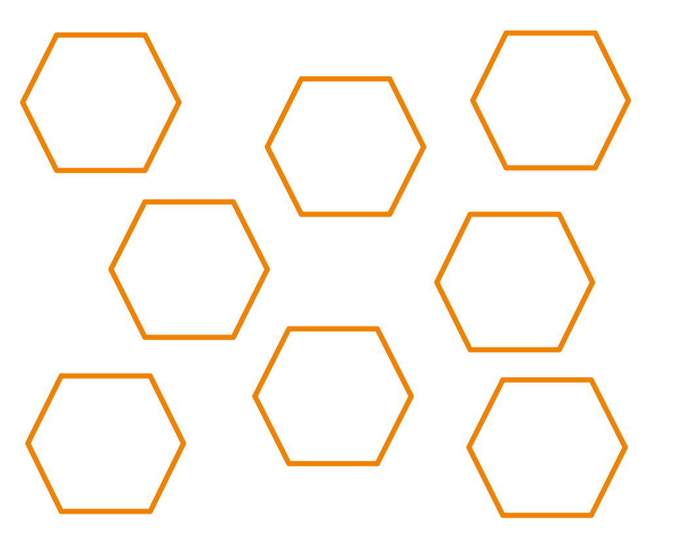
Hexagonal Thinking: An Activity
Notes:
Show students one of the hexagons from the Personal Finance Ecosystem Hexagonal Thinking Set and explain the activity:
Pairs of students will join to form groups of four.
Each group will be given a set of hexagons.
The hexagons each have a factor that financial experts think might influence a person’s financial well-being.
The challenge is to find commonalities between the factors. When two factors have something in common, they can be placed next to each other. When three hexagons come together at a point, all three should have something in common.
The goal is to get as many factors to connect as possible.
There is no right or wrong answer to this activity. Each group’s responses, connections and shape are expected to look different.

Slide 6
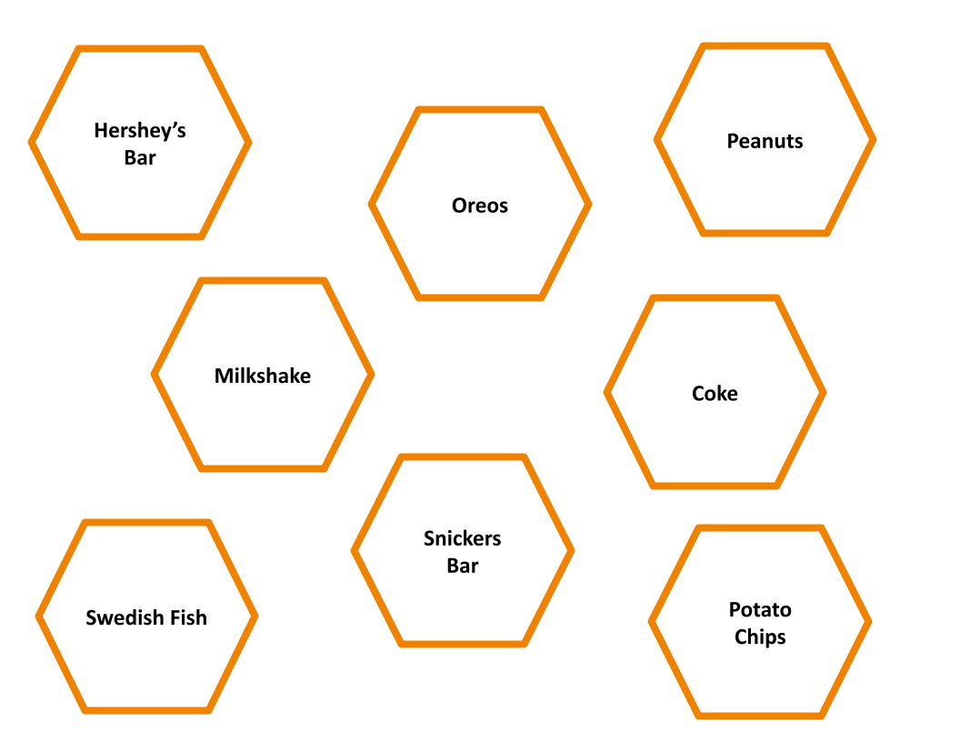
Sweets and Snacks: An Example
Notes:
This example uses sweets and snacks. Remind students that the goal is to look for commonalities between hexagons. The hexagons will then be arranged in a grid where every edge that touches indicates some relationship or commonality that the students can explain.

Slide 7
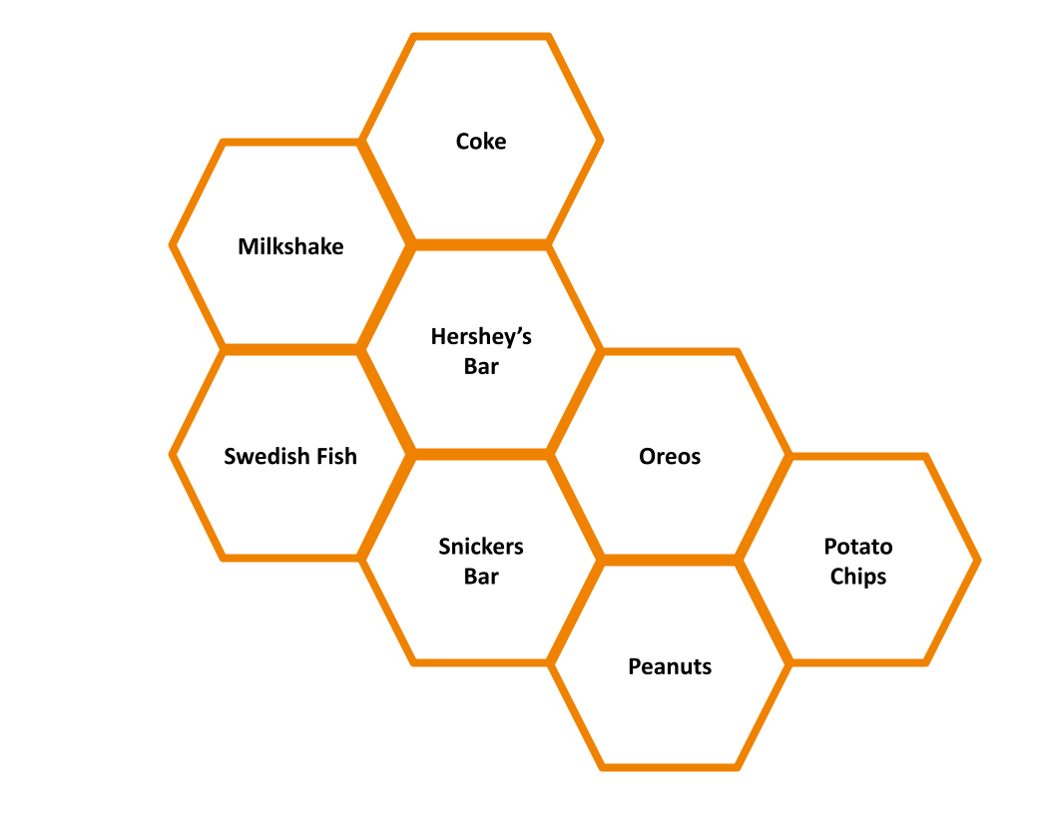
Sweets and Snacks: A Honeycomb
Notes:
Here’s an example of how students might arrange these particular hexagons.
They might find multiple connections for a Hershey’s bar. It is sweet like Coke. It is considered a candy, like Swedish Fish. It is chocolate like a chocolate milkshake, a Snickers bar, or an Oreo.
Meanwhile, they might say that a Snickers bar, Oreos, and peanuts all have some crunch. Snickers bars have peanuts. Peanuts and chips are both crunchy and salty.

Slide 8
Hexagonal Thinking: An Activity
Each hexagon represents something that might influence a person’s financial well-being
Review the contents with your group members
Use the blank hexagons for items you brainstormed that aren’t part of the hexagons you received
Work together to create a shape where edges and corners touch to reflect a commonality
Notes:
Remind students that blank hexagons can be used for factors that were identified during the brainstorm and are not found on any of the hexagons in the set.
(For the digital version: Direct students to move the hexagonal shapes on the slide to make connections. They may need to adjust their view by zooming in and out. Blank hexagons can be typed on and/or copied to create additional custom
factors.)
Provide students time to work in their groups and monitor group work.
Encourage students who might struggle. If needed, share that one strategy for getting started is to find a hexagon that easily connects to many others. Use this hexagon as a starting point and build out from there.
If students work quickly, ask them to explain and possibly reconsider some of their connections.
Praise students who are engaged in substantive conversations.
You can may want to inform students that you want them to take a “gallery walk” to see how other groups placed their hexagons. They should circulate from one group’s work to another and then return to their own. As one might do in an art gallery, the goal is to look and not touch. As they do this, consider taking a photo of each group’s finished work.

Slide 9
Let’s Debrief: Placement
Were you able to find a place for all of your hexagons? If not, how many could not be placed?
How would you describe your final shape? Compact with most hexagons touching? Loose with “extensions”
Tell me about one of your “central” hexagons — one that connected to six others. Why was it easy to make connections for that one?
Which hexagons were harder to “fit” than others? Why?
Notes:
Debrief the activity with the following questions, or provide each group with a copy of the Hexagonal Thinking Debrief to complete:
Placement:
Were you able to find a place for all of your hexagons? If not, how many could not be placed?
How would you describe your final shape? Compact with most hexagons touching? Loose with extensions?
Tell me about one of your central hexagons — one that is connected to six others. Why was it easy to make connections for that one?
Which hexagons were harder to fit than others? Why?

Slide 10
Let’s Debrief: Content
If you created your own hexagons, what were they and did you find good fits for them?
Which factors do you think would have a greater impact on a person’s financial well-being than others?
Which ones can be controlled by the individual? Which cannot?
Notes:
Content:
If you created your own hexagons, what were they, and did you find good fits for them?
Which factors do you think would have a greater impact on a person’s financial well-being than others?
Which factors can be controlled by the individual? Which cannot?

Slide 11
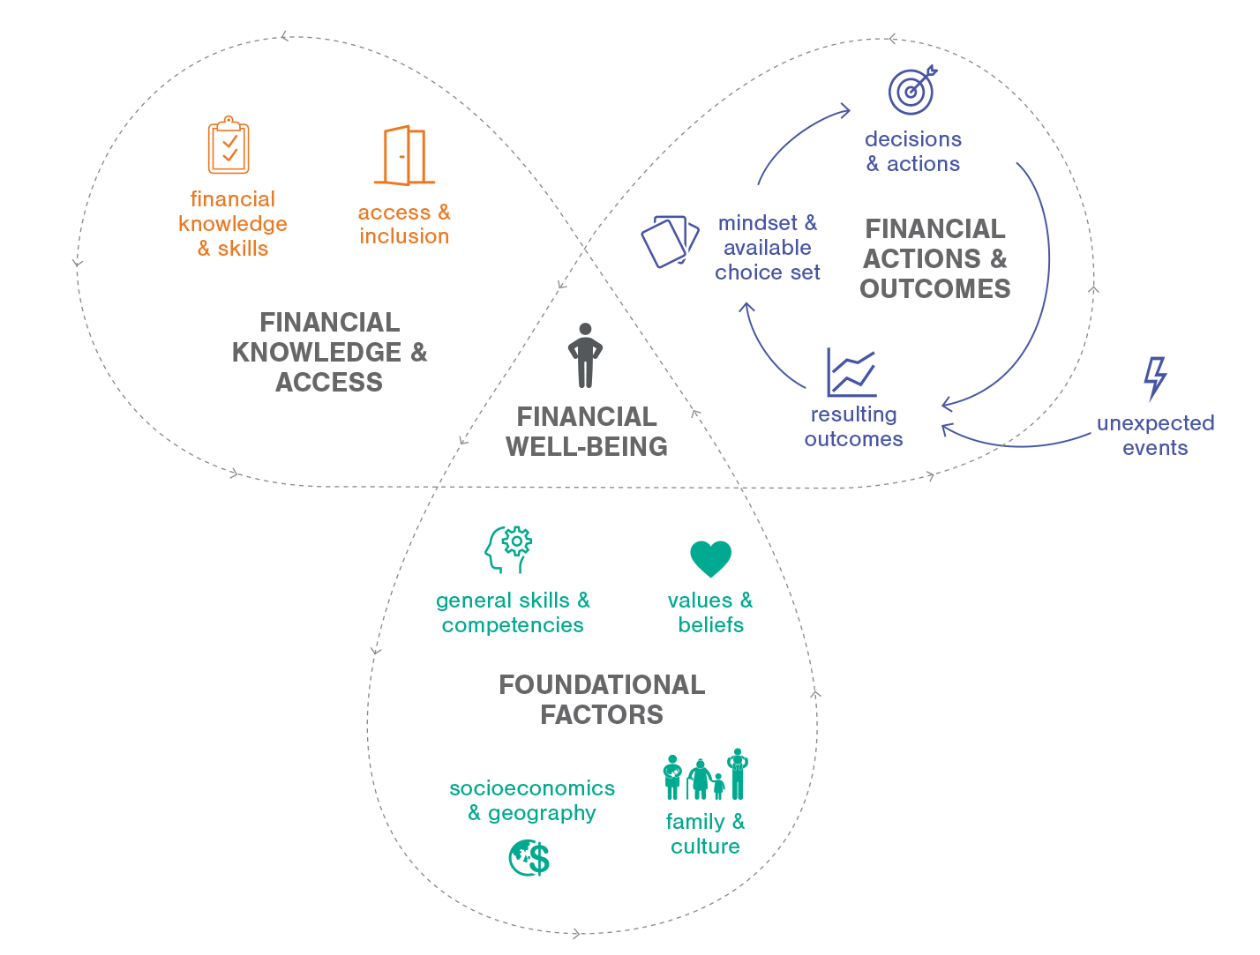
Core Elements of the Personal Finance Ecosystem
Notes:
Distribute a copy of the Core Elements of the Personal Finance Ecosystem to each student and/or display a digital copy.
Direct students to examine the diagram. What do they think it is trying to convey?
Explain that the Personal Finance Ecosystem is a framework that illustrates what impacts a person’s financial well-being. Point out that financial well-being is at the center of the diagram. There are three clusters of factors that impact financial well-being. Ask students to name them or point them out (Financial Knowledge and Access, Foundational Factors, and Financial Actions and Outcomes).

Slide 12
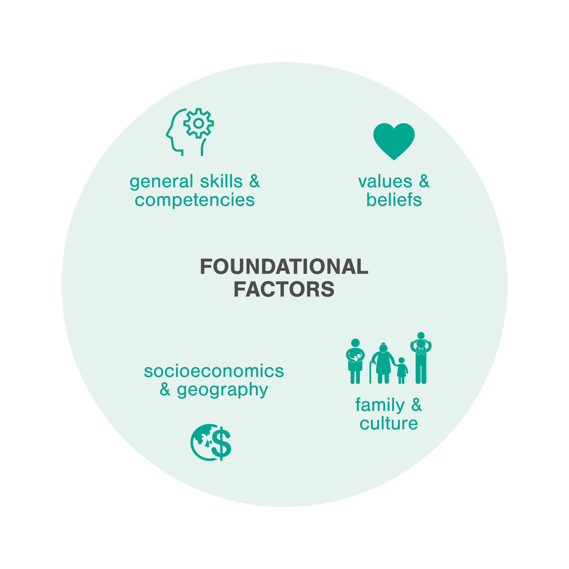
Foundational Factors
Wide variety of aspects that influence each part of the framework
Factors are relevant for all individuals, but uniquely influence each person
Includes both internal and external factors
Notes:
Slides 12-18 are optional and provide additional background on the Personal Finance Ecosystem. There are additional notes for background as well as some discussion prompts. Many of these slides/notes are also provided as optional in the Financial Well-Being and You deck.
The foundational factors are just that – foundational and underlying.
Discussion Prompts:
What else can you think of that has a foundation?
How does the foundation influence other parts? (Potential examples: a home or building, a cheerleading “pyramid,” a stack of wood)

Slide 13


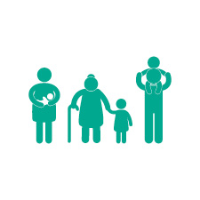

Foundational Factors
General Skills and Competencies
Values and Beliefs
Family and Culture
Socioeconomics and Geography
Includes basic literacy and numeracy, problem-solving skills, critical thinking, information literacy, executive function, self-advocacy, communication, and persistence.
Includes internal factors like motivation, affect, attitudes, cognitive bias, time discounting, risk preference, stress, trust in the financial system, and other mental constructs.
Includes personal factors like family socialization, family composition, and culture.
Includes overarching factors like the state of the economy, socioeconomics and systemic inequality, and issues specific to a particular region or locale.
Notes:
General Skills and Competencies include things like basic literacy and numeracy, problem-solving skills, and executive function.
Values and Beliefs include important mental constructs like motivation, affect, attitudes, cognitive bias, time discounting, risk preference, and stress. These are considered foundational because many of these impact a person’s willingness to learn in the first place. Trust in the financial system is here because it often affects a person’s willingness to engage with other parts of the Ecosystem.
Family and Culture include family socialization and how family composition can affect someone’s financial life. For example, is it a mutigenerational household? Has an individual experienced divorce? How many children are there? What is their documentation status?
Socioeconomics and Geography touch on economic disparities and systemic inequities that people experience. It also acknowledges that many economic opportunities and challenges are place-based and can vary widely by region and even zip code.
Discussion Prompts:
How do you picture each of these impacting a person’s financial well-being?
Do you think one of these is more important than the others? Why?

Slide 14
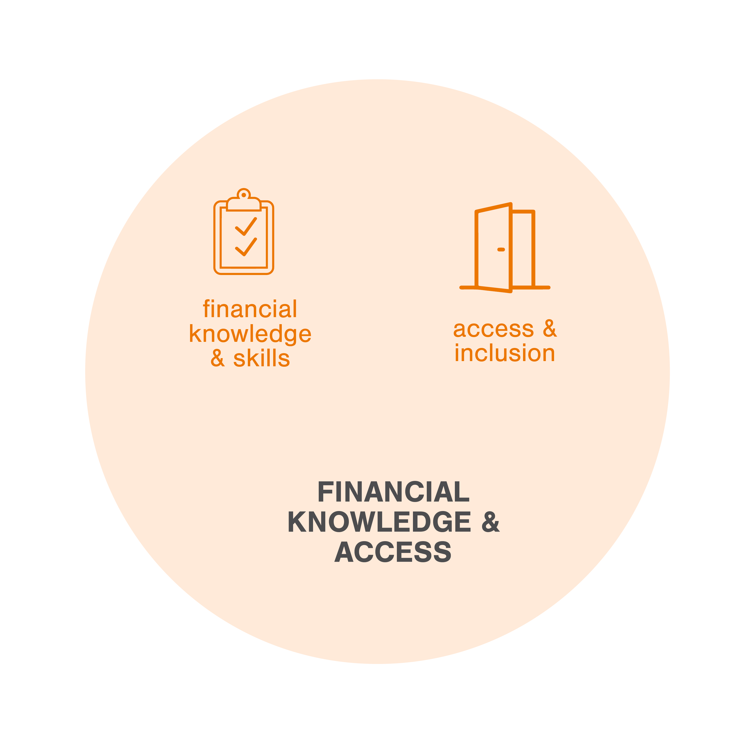
Financial Knowledge and Access
An individual’s ability to act in their own self-defined best financial interest
Comprised of two key elements:
Financial knowledge and skills to decide or act
Opportunity to take action and exercise choice within financial society
Notes:
Financial knowledge and access are key to financial well-being.
Discussion Prompts:
Aside from classes in personal finance, how might people gain financial knowledge and skills?
What do you think is meant by access and inclusion?

Slide 15


Financial Knowledge and Access
Financial Knowledge and Skills
Access and Inclusion
Financial Knowledge: Objective mastery of financial definitions, terms and concepts.
Financial Skills: Determines whether an individual can make decisions with that knowledge.
Skill puts knowledge into action!
Participation in Financial Society: The opportunity and awareness to take action and exercise choice within financial markets, the financial services industry, and all aspects of financial life.
Many individuals face systemic barriers to full inclusion.
Notes:
Financial Knowledge and Skills can be built through formal or informal education and training. Some people might say they gain financial knowledge from “the school of hard knocks.” In other words, they learn from their experiences what not to do.
People lack Access and Inclusion in financial society in many ways. For example, people who live in very rural areas often lack access to financial institutions. There are also systemic barriers to inclusion, such as discrimination in lending.
Discussion Prompts:
How have you gained financial knowledge and skills? Do you think people learn better from education or experience?
Do you think people in your community have full access and inclusion in financial society? Can you think of other examples where people lack this access or inclusion?

Slide 16
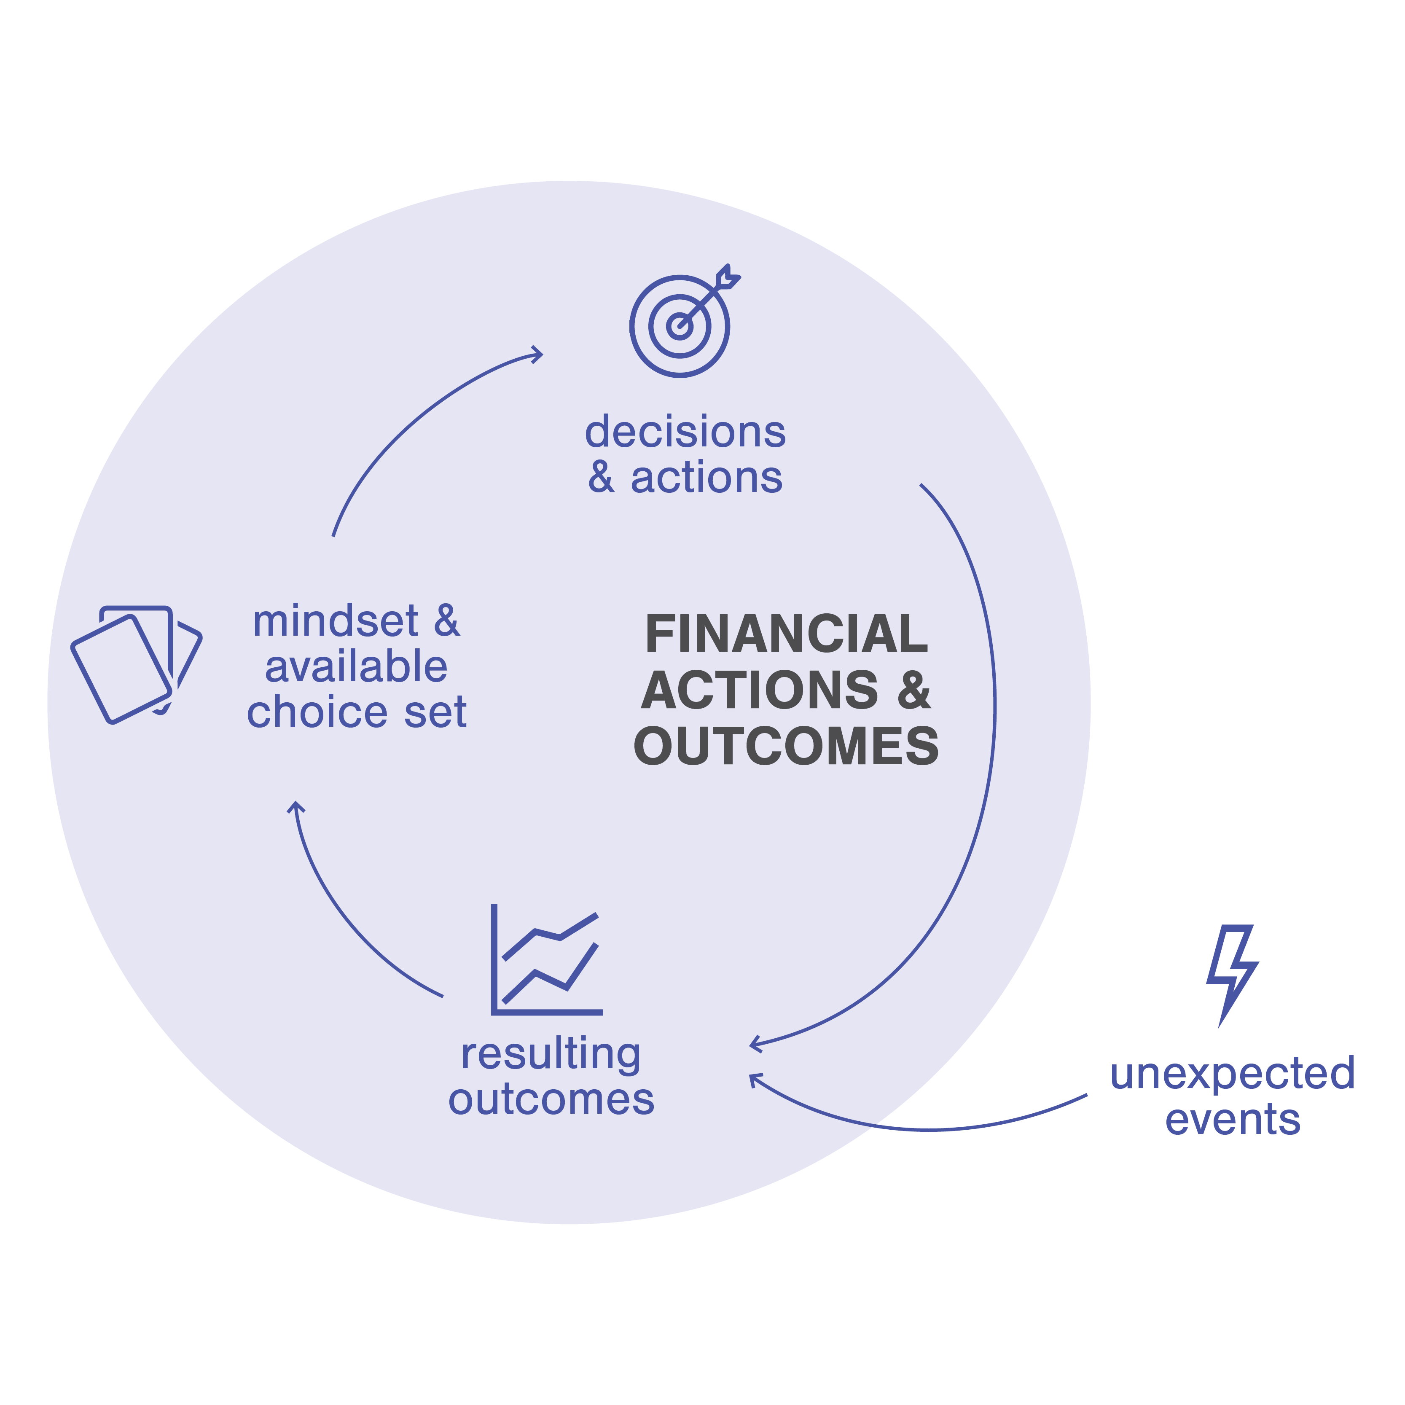
Financial Actions & Outcomes
We all make frequent financial decisions, large and small
Cycle starts with Mindset & Available Choice Set
  Financial knowledge and skill
  play a big part here
Decisions & Actions lead to Outcomes
Unexpected Events can also affect outcomes/feelings
Notes:
The Financial Actions and Outcomes Cycle is a feedback loop made up of mindset and available choice set, decisions and actions, and the resulting outcomes from those decisions. These outcomes in turn affect mindset and choice set, and so on.
This is where financial decision-making lives within this framework. While Financial Well-Being is something you define for yourself, the financial actions that you take and the results of those actions play a large part in that well-being. People make financial decisions all the time, from daily purchasing decisions to big-picture choices like whether to go to college, where to live, or what job to take.
The starting point of this cycle is mindset and available choice set, which is how you feel about the decision going into it and what choices are actually on the table for you to make. Financial Knowledge and Skill have a big part to play here, including your confidence, your objective knowledge, and how you apply that knowledge to the choice at hand. If you can act in your own best financial interest, your mindset and available choices will likely shift.
Once a financial decision or action is made, an outcome happens. These are both objective (like having a new bank account) and subjective (like feelings of satisfaction).
Outcomes also happen from unexpected events, like getting a flat tire and having to pay to replace it. Or maybe it’s a positive unexpected event, like a raise at work. It’s important to note that not all financial disruptions can be prepared for or are an outflow of financial decisions and actions. Like several other components of the Ecosystem, there are some things that an individual cannot change or control, but they still impact the outcomes that a person experiences.
How you feel about this ongoing relationship between mindset, actions, and outcomes—or the subjective impact they have on your situation—feed into well-being.
Discussion Prompts:
What are some unexpected events that might impact a person’s financial decisions?
How could mindset influence a person’s financial decisions and actions?

Slide 17




Financial Actions and Outcomes Cycle
Mindset and Available Choice Set
Decisions and Actions
Resulting Outcomes
Unexpected Events
A set of mental attitudes at the time of a financial decision and choices that are available to an individual at any given time.
The presence or absence of decisions made and actions taken by an individual.
Outcomes can be objective (confidence) or subjective (credit score); can result from decisions and actions as well as from unexpected events.
Economic shocks that a person experiences; can be positive (a wage increase) or negative (large medical bill, job loss).
Notes:
This shows more details about each component of the cycle. Remember, this is a continuous loop that repeats with each additional decision or action.
Discussion Prompts:
Think of a financial decision that you or someone you know has made.
Can you identify the components of this loop?
What mindset did you or the other person have going into the decision? What choices were available at the time?
What decision was made or action taken?
Was an unexpected event involved?
What was the resulting outcome?
How will this experience impact future financial actions?

Slide 18
Review: Core Elements
Notes:
Challenge students to make comparisons between the Ecosystem diagram and the hexagons they used before. Name specific aspects of the diagram (for example, Financial Knowledge and Skills), and ask which hexagons could fall under that category. Work through several examples and allow students to explain their reasoning. If needed, point out that some factors might fit into more than one category, depending on the point of view of the individual. Reference the Making Connections Facilitation Guide for potential connections and additional information that can add to the conversation.
Conclude by asking students to write a personal definition of financial well-being and/or create a list of factors they can control to influence their financial well-being going forward.

